Slide 1
Explain Vulnerability Management
CompTIA Security+ Exam SY0-701
Lesson 8

Slide 2
Device and OS Vulnerabilities
Lesson 8
Topic 8A

Slide 3
Operating System Vulnerabilities
Vulnerabilities in an OS can lead to significant problems when successfully exploited
Microsoft Windows Client and Server
Apple macOS
Linux
Android
iOS
Notes:
The significance of MS17-010 is tied closely to the EternalBlue exploit, which leveraged the vulnerabilities in early versions of the SMB protocol for malicious purposes. The most famous misuse of EternalBlue was during the WannaCry ransomware attack in May 2017, where it was used to propagate the ransomware across networks worldwide, leading to massive damage and disruption. This event underlined the critical importance of timely system patching and reinforced the potential global impact of such vulnerabilities.

Slide 4
Vulnerability Types
Legacy Systems
End-of-Life (EOL) Systems
Firmware Vulnerabilities
Virtualization Vulnerabilities
Application Vulnerabilities
Notes:
Make sure students can contrast the support available when a product is EOL with EOSL.

Slide 5
Zero-Day Vulnerabilities
Previously unknown software or hardware flaws.
Developers have "zero days" to fix once the vulnerability becomes known
Traditional security measures like antivirus and firewalls are often ineffective
Zero-day vulnerabilities have significant financial value
Adversaries generally use a zero-day vulnerability against high-value targets
Notes:
The term "zero-day" is usually applied to the vulnerability itself but can also refer to an attack or malware that exploits it.

Slide 6
Misconfiguration Vulnerabilities
Common cause of security vulnerabilities
Default configurations
  Hardware/devices
  Software
  Cloud services
Using search engine results to solve technical problems

Slide 7
Cryptographic Vulnerabilities
Cryptography forms the backbone of secure communication
Weaknesses in cryptographic systems, protocols, or algorithms
  Methods no longer deemed secure
  Weak Keys
  Misconfigured cipher suites
Improperly protected keys
Notes:
Kerckhoffs's principle establishes that a cryptosystem should be secure, even if everything about the system, except the key, is public knowledge.

Slide 8
Sideloading, Rooting, and Jailbreaking
Rooting and jailbreaking are methods used to gain elevated privileges on mobile devices
Rooting - gaining root access or administrative privileges on an Android device
Jailbreaking - gaining full access to an iOS device (iPhone or iPad)
Sideloading - installing applications from sources other than the official app store
  F-Droid
  Android APK (Android Application Package) files
Notes:
Detecting whether a device has been rooted is not straightforward. You might want to point students to Google's attestation API documentation for more information on root detection (developer.android.com/training/safetynet/attestation).

Slide 9
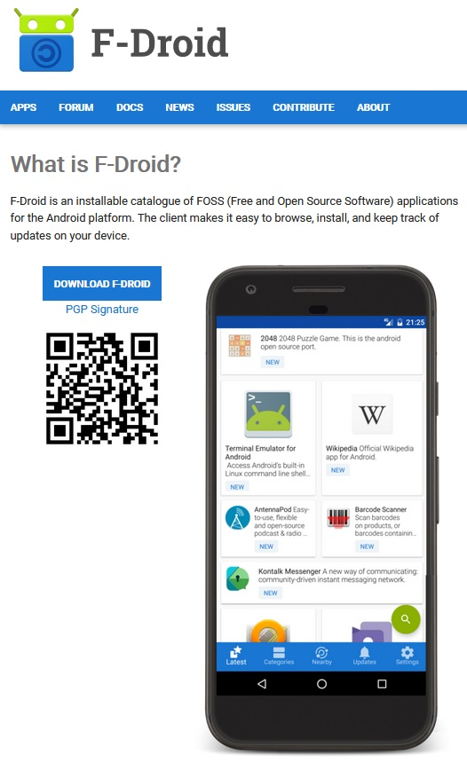
Sideloading, Rooting, and Jailbreaking
Rooting and jailbreaking are methods used to gain elevated privileges on mobile devices
Rooting
  Gaining root access or administrative privileges on an Android device
Jailbreaking
  Gaining full access to an iOS device (iPhone or iPad)
Sideloading
  Installing applications from sources other than the official app store
  F-Droid
  Android APK (Android Application Package) files
The F-Droid Android application store. (Screenshot courtesy of www.opensecurityarchitecture.org.)
Notes:
Detecting whether a device has been rooted is not straightforward. You might want to point students to Google's attestation API documentation for more information on root detection (developer.android.com/training/safetynet/attestation).

Slide 10
Device and OS Vulnerabilities
Operating System Vulnerabilities
Vulnerability Types
Zero-Day Vulnerabilities
Misconfiguration Vulnerabilities
Cryptographic Vulnerabilities
Sideloading, Rooting, and Jailbreaking
Notes:
Take some time at the end of each topic to answer questions. You can use the review questions for discussion in class or set them for students to complete individually during or after class.

Slide 11
Application and Cloud Vulnerabilities
Lesson 8
Topic 8B

Slide 12
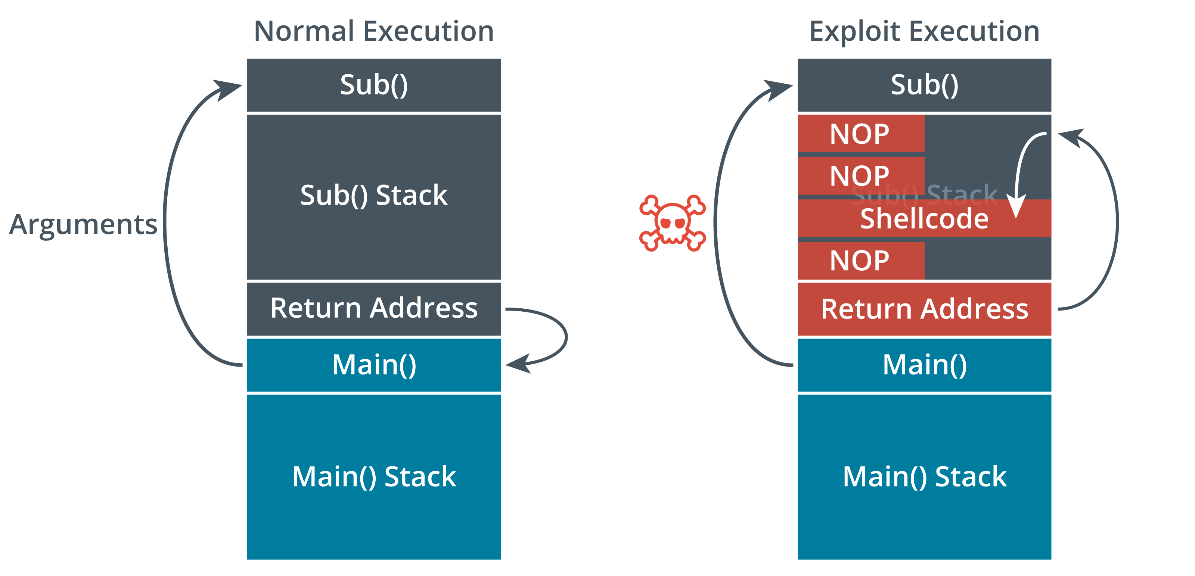
Application Vulnerabilities
Race Condition
Time-of-check to time-of-use (TOCTOU)
Memory Injection
Buffer Overflow
Type-Safe Programming Languages
Malicious Update
When executed normally, a function will return control to the calling function. If the code is vulnerable, an attacker can pass malicious data to the function, overflow the stack, and run arbitrary code to gain a shell on the target system.
Notes:
The description of TOCTOU can be expanded by highlighting the common areas where TOCTOU vulnerabilities are typically found. For instance, they're common in file systems and shared databases.

Slide 13
Evaluation Scope
Scope refers to the product, system, or service being analyzed for potential security vulnerabilities
Practices
  Security Testing
  Documentation Review
  Source Code Analysis
  Configuration Assessment
  Cryptographic Analysis
  Compliance Verification
  Security Architecture Review

Slide 14
Web Application Attacks
Specifically target applications accessible over the Internet
Cross-Site Scripting (XSS)
Cross-Site Request Forgery (CSRF)
SQL Injection (SQLi)
Notes:
CSRF is discussed in more depth in Lesson 13
Make sure students can identify code that performs XSS.
Also check that students understand the difference between XSRF and XSS. XSRF spoofs a specific request against the web application; XSS is a means of running any arbitrary code. An XSS attack could be used to perform XSRF, for instance.

Slide 15
Cloud-based Application Attacks
Target applications hosted on cloud platforms
  Exploit potential vulnerabilities within the hosted applications
  Exploit cloud infrastructure the applications run on
Cloud As an Attack Platform
Cloud Access Security Brokers

Slide 16
Supply Chain
Potential risks and weaknesses introduced into products during their development, distribution, and maintenance lifecycle
Hardware Suppliers
Software Providers
  Software Bill of Materials
  Dependency Analysis and SBOM Tools
Notes:
Supply chain security is gaining in momentum and interest as more and more organizations are being impacted by supply chain attacks. Consider having an in-class discussion regarding this topic to emphasis its significance.

Slide 17
Application and Cloud Vulnerabilities
Application Vulnerabilities
Evaluation Scope
Web Application Attacks
Cloud-based Application Attacks
Supply Chain
Notes:
Take some time at the end of each topic to answer questions. You can use the review questions for discussion in class or set them for students to complete individually during or after class.

Slide 18
Assisted Lab: Exploiting and Detecting SQLi

Slide 19
Vulnerability Identification Methods
Lesson 8
Topic 8C

Slide 20
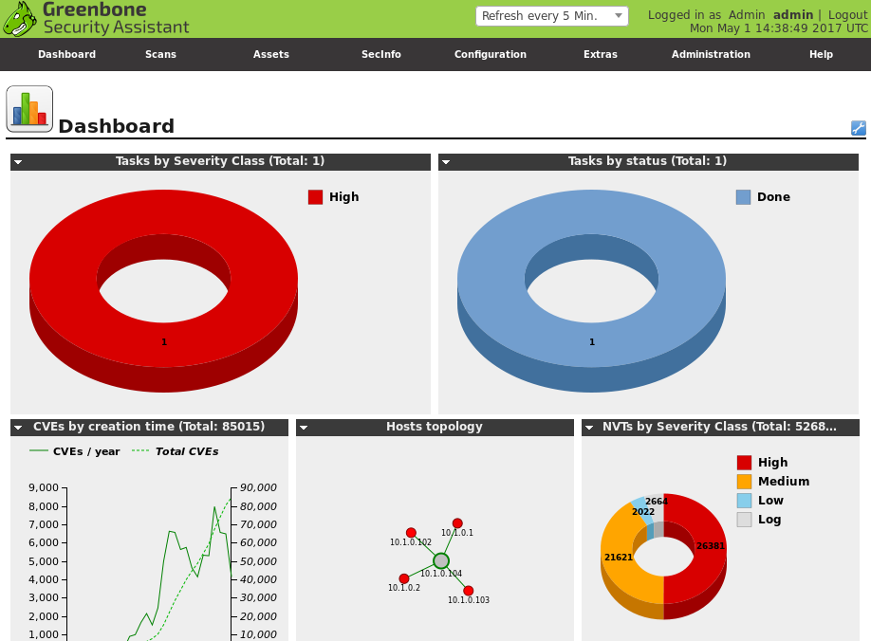
Vulnerability Scanning
Cornerstone of modern cybersecurity practices
Focused on identifying, classifying, remediating, and mitigating vulnerabilities
Helps to locate and identify misconfigurations
Greenbone OpenVAS vulnerability scanner with Security Assistant web application interface as installed on Kali Linux. (Screenshot used with permission from Greenbone Networks, http://www.openvas.org.)

Slide 21
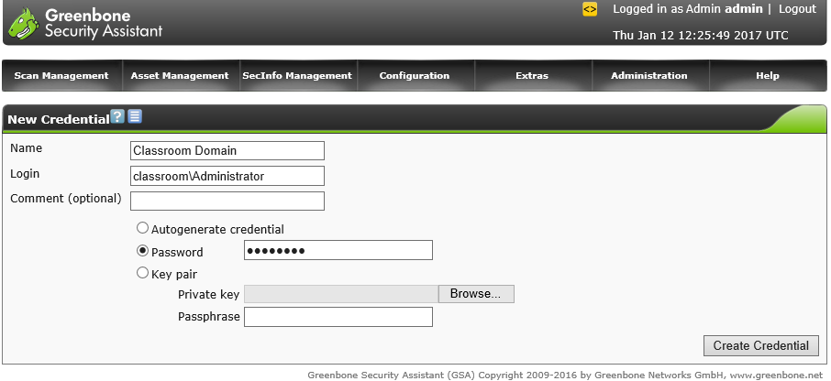
Vulnerability Scanning
Network Vulnerability Scanners
Tenable Nessus
OpenVAS
Credentialed and Non-Credentialed Scans
Application and Web Application Scanners
Package Monitoring
Configuring credentials for use in target (scope) definitions in Greenbone OpenVAS as installed on Kali Linux. (Screenshot used with permission from Greenbone Networks, http://www.openvas.org.)

Slide 22
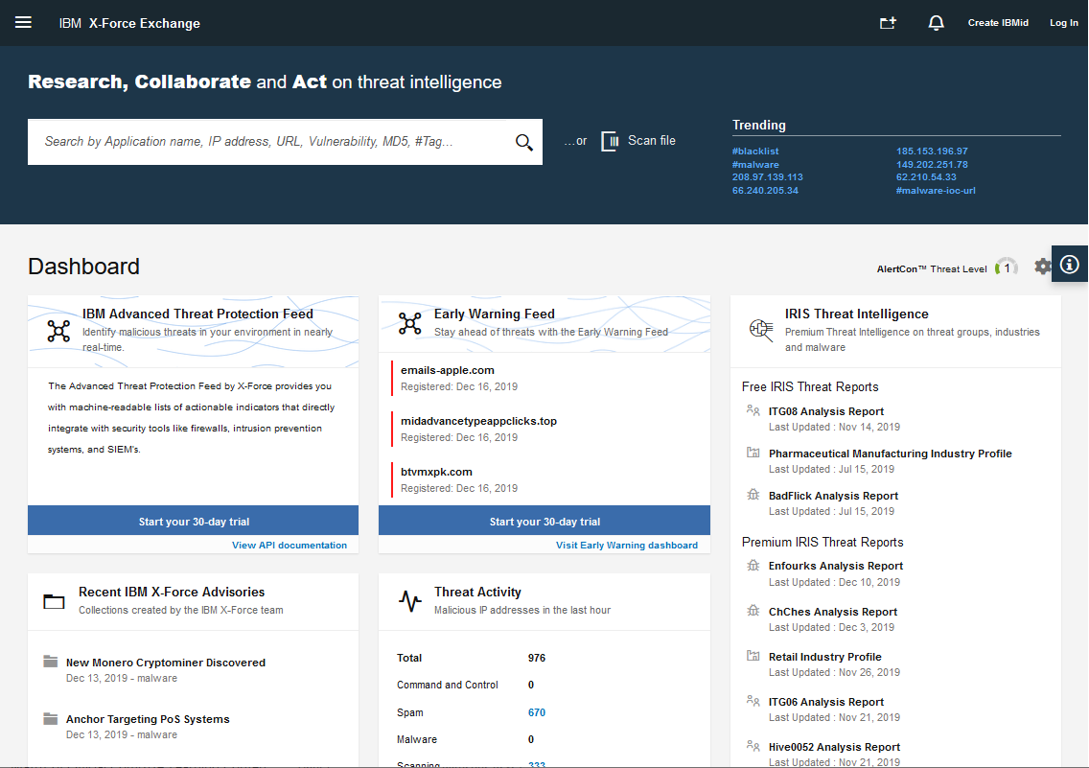
Threat Feeds
Real-time, continuously updated sources of information about potential threats and vulnerabilities
Provide timely information and context about new threats
IBM X-Force Exchange threat intelligence portal. (Image copyright 2019 IBM Security exchange.xforce.ibmcloud.com.)
Notes:
Interaction Opportunity: Show some other threat map examples, such as CheckPoint's (threatmap.checkpoint.com). Kaspersky's is visually impressive too (cybermap.kaspersky.com).

Slide 23
Threat Feeds
Open-source and proprietary threat feeds
  IBM X-Force Exchange
  Mandiant's FireEye
  Recorded Future
  Proofpoint Emerging Threats
  Abuse.ch
Information-Sharing Organizations
  Information Sharing and Analysis Centers (ISACs)
Open-Source Intelligence
  Search engines, blogs, forums, social media platforms, and the dark web
Notes:
Thread feeds are critically important as they provide details and awareness about current and emerging threats to help cyber operatioins focus their attention on current topics and better understand what issues and indicators to look for.

Slide 24
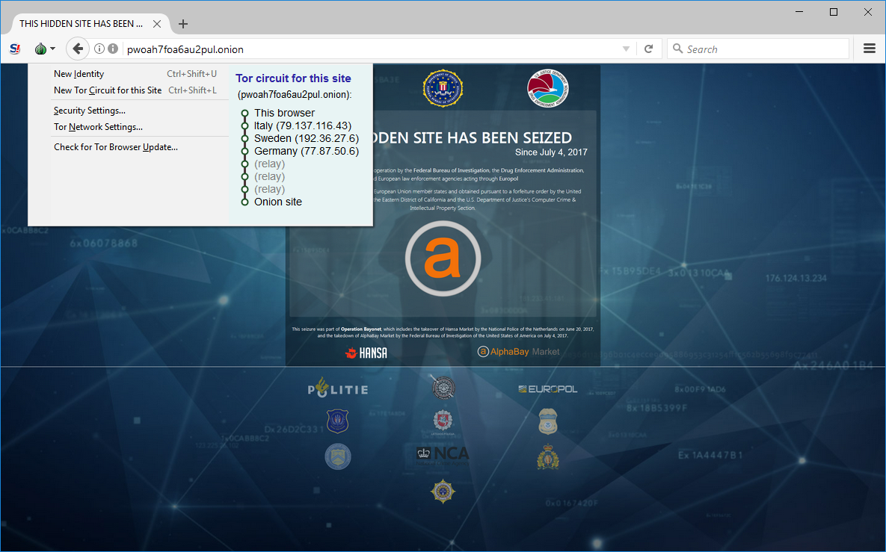
Deep and Dark Web
Deep Web
  Any part of the World Wide Web that is not indexed by a search engine
Dark Net
  A network established as an overlay to Internet infrastructure, such as The Onion Router (TOR), Freenet, or I2P, that acts to anonymize usage
Dark Web
  Sites, content, and services accessible only over a dark net
Using the TOR browser to view the AlphaBay market, now closed by law enforcement. (Screenshot used with permission from Security Onion.)

Slide 25
Other Vulnerability Assessment Methods
Penetration Testing
  Unknown environment (previously black box) testing
  Known environment (previously white box) testing
  Partially known environment (previously gray box) testing
Bug Bounties
Auditing
Notes:
You should not spend too much time on this topic—just ensure that students are aware of these sources.

Slide 26
Vulnerability Identification Methods
Vulnerability Scanning
Threat Feeds
Deep and Dark Web
Other Vulnerability Assessment Methods
Notes:
Take some time at the end of each topic to answer questions. You can use the review questions for discussion in class or set them for students to complete individually during or after class.

Slide 27
Assisted Lab: Working with Threat Feeds

Slide 28
Vulnerability Analysis and Remediation
Lesson 8
Topic 8D

Slide 29
Common Vulnerabilities and Exposures
Vulnerability Feed
National Vulnerability Database (NVD)
Security Content Automation Protocol (SCAP)
Common Vulnerabilities and Exposures (CVE)
Common Vulnerability Scoring System (CVSS)
CVSS Score | Description
0.1+ | Low
4.0+ | Medium
7.0+ | High
9.0+ | Critical

Slide 30
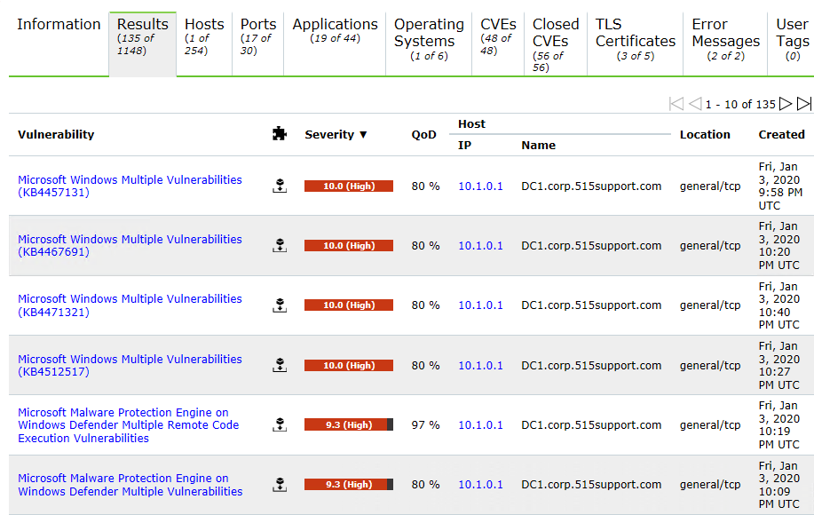
False Positives, False Negatives, and Log Review
False Positive
Scanner or another assessment tool incorrectly identifies a vulnerability
False Negatives
Vulnerabilities that go undetected in a scan
Validate vulnerability reports by examining logs
Scan report listing multiple high-severity vulnerabilities found in a Windows host. (Screenshot: Greenbone Community Edition greenbone.net/en/community-edition.)

Slide 31
Vulnerability Analysis
Prioritization
Classification
Exposure Factor
Impacts
Environmental Variables
Risk Tolerance
Notes:
Prioritization is very important in vulnerability analysis. Vulnerability scans can uncover an overwhelming number of issues but only a subset warrant swift and decisive action.

Slide 32
Vulnerability Response and Remediation
Remediation Practices
  Patching
  Cybersecurity insurance
  Segmentation
  Compensating controls
  Exceptions and exemptions
Validation
  Re-scanning
  Auditing
  Verification
  Reporting

Slide 33
Vulnerability Analysis and Remediation
Common Vulnerabilities and Exposures
False Positives, False Negatives, and Log Review
Vulnerability Analysis
Vulnerability Response and Remediation
Notes:
Take some time at the end of each topic to answer questions. You can use the review questions for discussion in class or set them for students to complete individually during or after class.

Slide 34
Assisted Lab: Performing Vulnerability Scans

Slide 35
Summary
CompTIA Security+ Exam SY0-701
Lesson 8

